Slide 1
Data Analysis of Super Market Sales Order

Slide 2
Note: The output of each task should be created and saved in a separate Tableau Workbook. All the charts need to have appropriate​​ chart titles.​

Slide 3
Data Dictionary
Fields/Columns
Description
Product Category :Product category (Furniture, Office Supplies and Technologies)
Sales Generated sales amount
Latitude:Latitude of location (in Tableau)
Longitude:Longitude of location (in Tableau)
Country:Name of the country
Region:Name of the region
Product Sub-Category :Product subcategory (Home Office, Consumer, etc.)
City: Name of the city
Postal Code:Postal code of the location
State or Province:Name of the state
Ship Date:Date of shipment
Quantity Ordered:Number of units ordered
Product Name:Name of the product

Slide 4
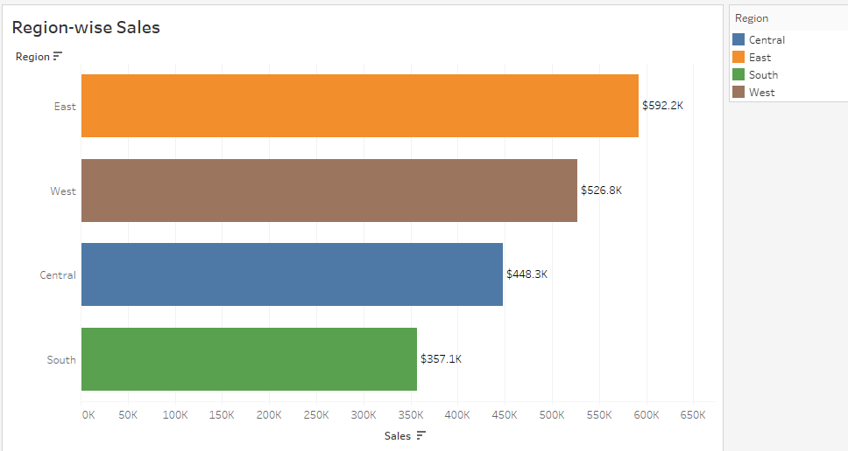
Problem statement 1
Display the sum of sales generated for each region using a bar chart.
Expected output

Slide 5
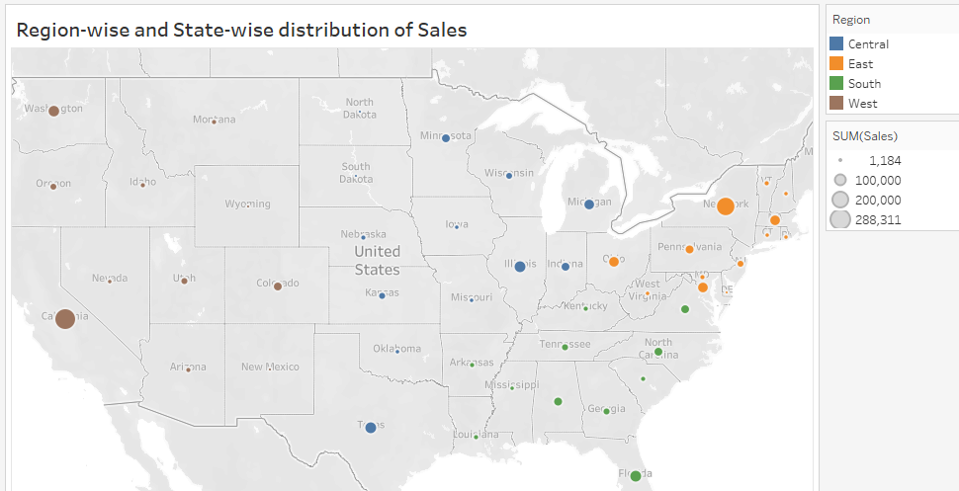
Problem Statement 2
Display region-wise and state-wise total sales using dot density chart.
Identify the states with the highest sales from East and West regions.
Hint Create a hierarchy named Geography with the following fields: Country,State or Province and City (Expected output shown below)

Slide 6
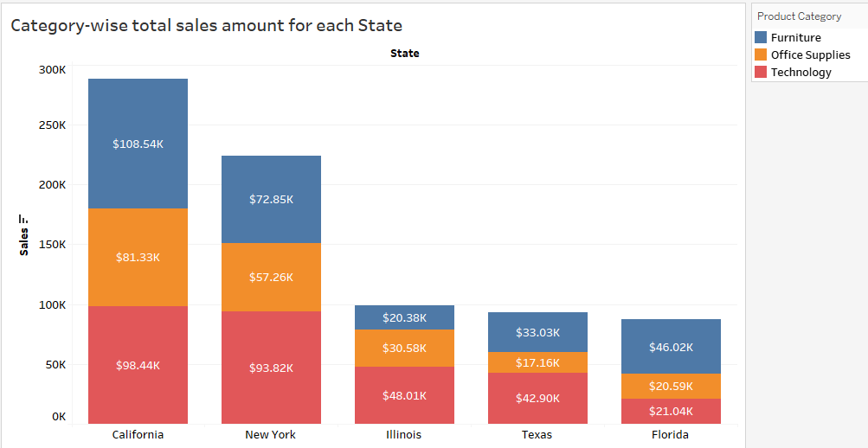
Problem Statement 3
Display product category-wise total sales amount for the following states: California, Illinois, New York, Texas and Florida
Note : Identify and write down the state name, along with the sales amount, that generated the highest sales amount.

Slide 7
Problem Statement 4
The management believes that a few cities in each of the following states contribute to the major share of revenue:
California
Illinois
New York
Texas
Florida
1. Validate the hypothesis based on the five states
provided in the previous slide.

Slide 8
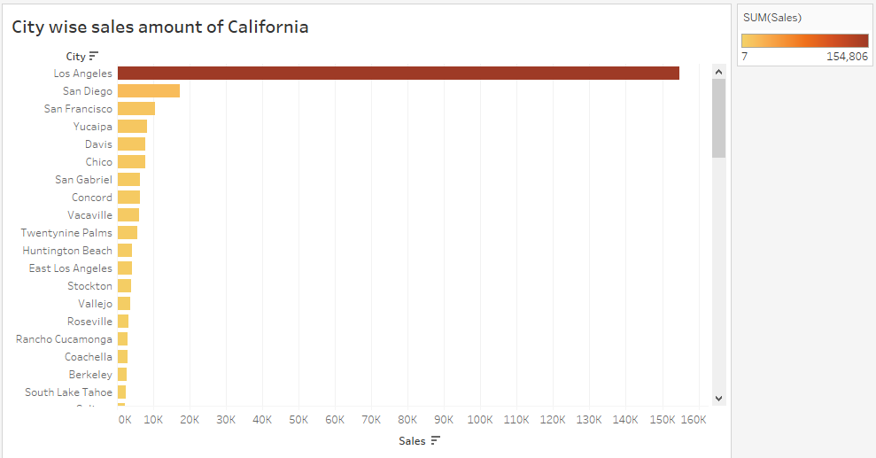
Expected output for the sales sum in cities of CA

Slide 9
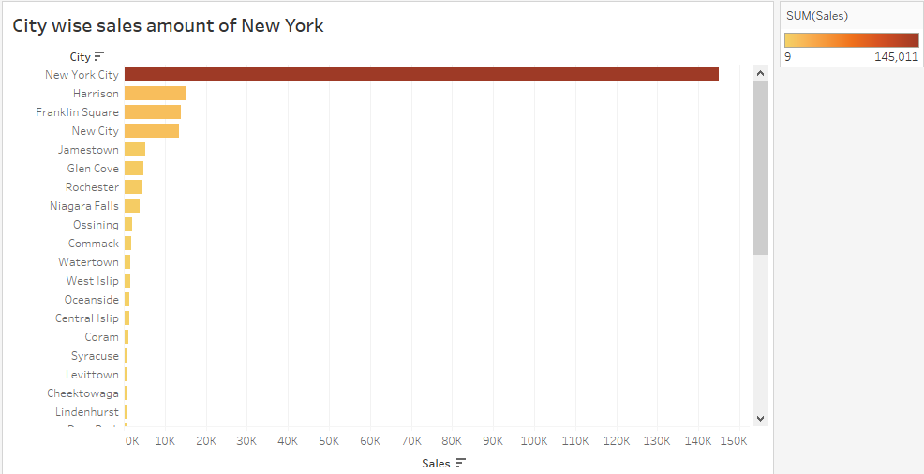
Expected o/p for the sum of sales in various cities in the state of New York

Slide 10
Problem Statement 5
The management wants to open physical outlets in the cities that make more than a thousand shipments annually. Perform the task given below and figure out the whether the management will open a physical store in any city of California.
Identify the top five cities of California with the highest number of shipments. Display the cities, their postal codes, and the number of shipments.
Note: The Expected Output is shown in the
upcoming slide.​​

Slide 11
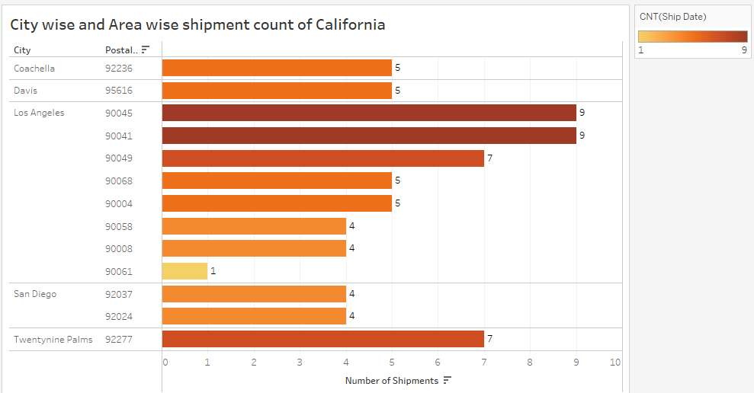
Expected ouput

Slide 12
Problem Statement 6
Display the top 5 selling products (based on quantity of products) and their corresponding subcategories using bar charts.
Display the top 5 selling products (based on total sales) and their corresponding subcategories using bar charts.
Write down and compare the product sub-categories identified in 6.1 and 6.2 Are there any common subcategories?

Slide 13
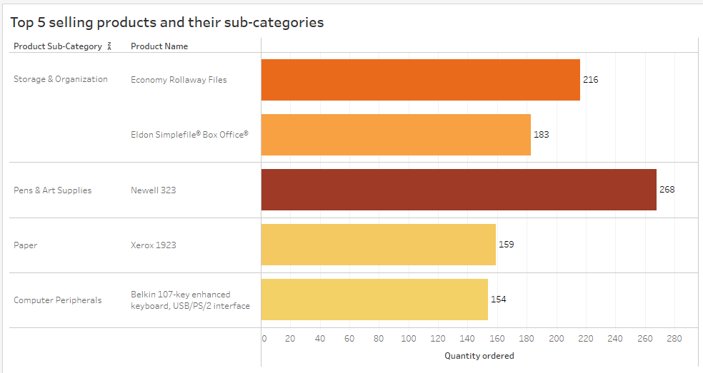
Expected output for the part 1 of the question

Slide 14
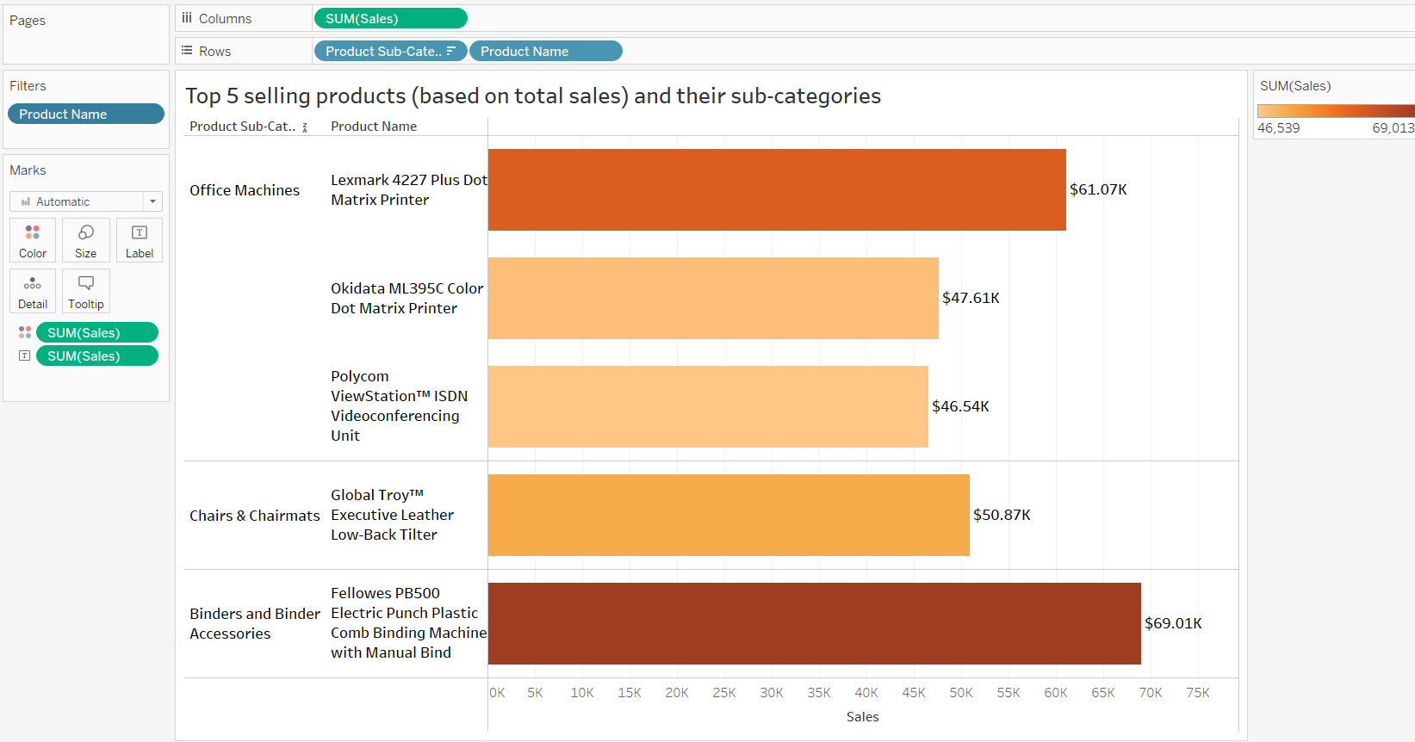
Expected output for the part 2 of the question

Slide 15
Problem Statement 7
Display the top 5 products (based on total sales) from each subcategory (identified in 6.2) along with the names of the products, their quantities sold, and the sales amounts:
Binders & Binders Accessories
Chairs & Chairmats
Office Machines
Note: The products in each subcategory need to be displayed in descending order of sales.
HINT : Create a calculated field named “Sales_Rank”. Following is the formula of the calculated field: Sales_Rank = Rank(Sum([Sales]))
NOTE : The Expected Output is shown in the upcoming slide.​​

Slide 16
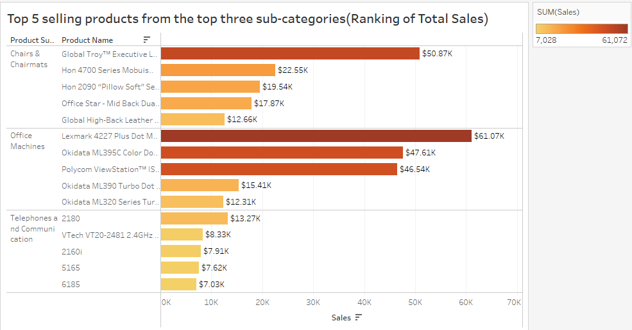
Expected output

Slide 17
Problem Statement 8
For the three subcategories mentioned in Task 7, determine the top 5 highest selling products (based on total sales) for two particular states, California and Illinois.
For the two states, determine whether at least 3 out of the top 5 highest selling products from each subcategory are same or not.

